Slide 1
Data Structures and Algorithms
Dr. Farshid Mehrdoust
Kiarash Dadpour
University of Guilan

Slide 2
01
Algorithm Analysis

Slide 3
The Complexity of an Algorithm
The complexity of an algorithm refers to the measure of the computational resources it requires, primarily time and space, as a function of input size n.
Time complexity quantifies the number of basic operations performed, while space complexity measures the amount of memory utilized.
Understanding complexity helps in comparing different algorithms and choosing the most efficient one for a given problem.

Slide 4
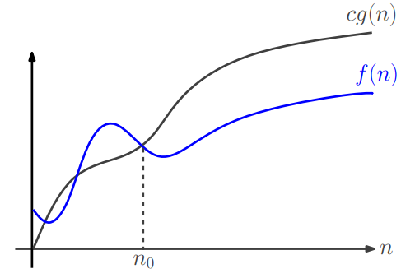
The Big-O Notation
O-notation characterizes an upper bound on the asymptotic behavior of a function.
In other words, it says that a function grows no faster than a certain rate, based on the highest-order term.

Slide 5
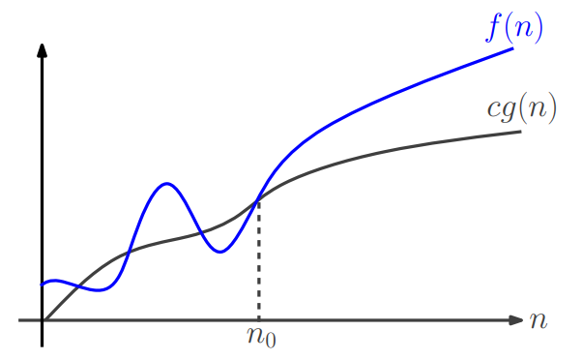
The Ω Notation
Ω-notation characterizes a lower bound on the asymptotic behavior of a function.
In other words, it says that a function grows at least as fast as a certain rate, based on the highest-order term.

Slide 6
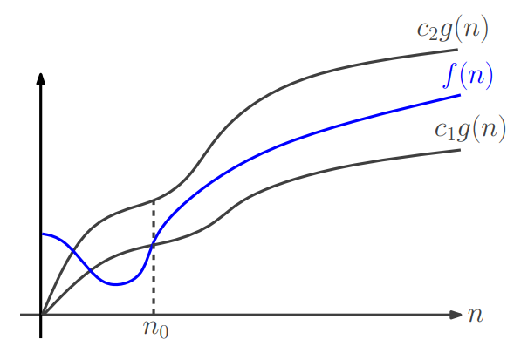
The θ Notation
θ-notation characterizes a tight bound on the asymptotic behavior of a function.
It says that a function grows precisely at a certain rate, based on the highest-order term.

Slide 7
Asymptotic Notation: Formal Definitions
O-notation:
Ω-notation:
θ-notation

Slide 8
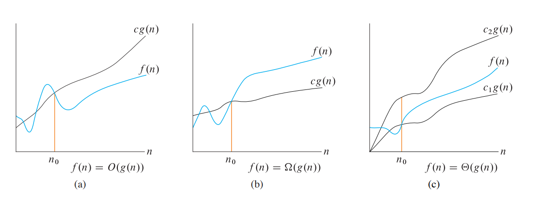
Asymptotic Notation: Formal Definitions

Slide 9
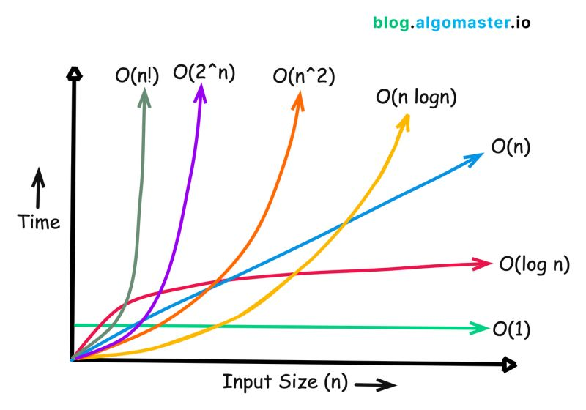
Different Time Complexities

Slide 10
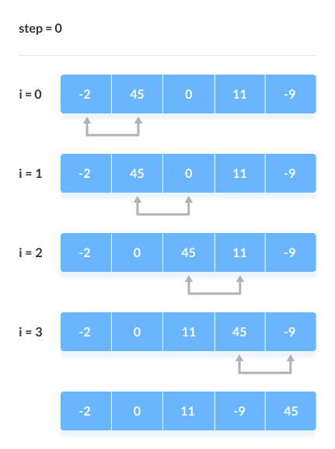
Bubble Sort

Slide 11
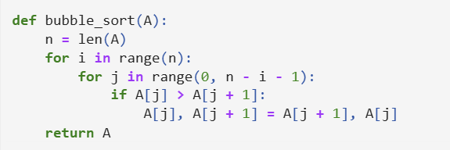
Bubble Sort

Slide 12
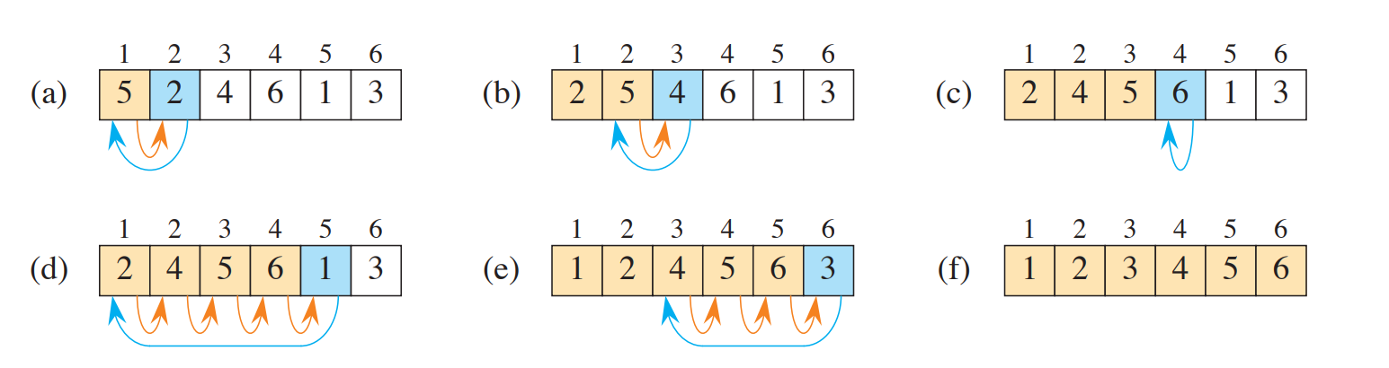
Insertion Sort

Slide 13
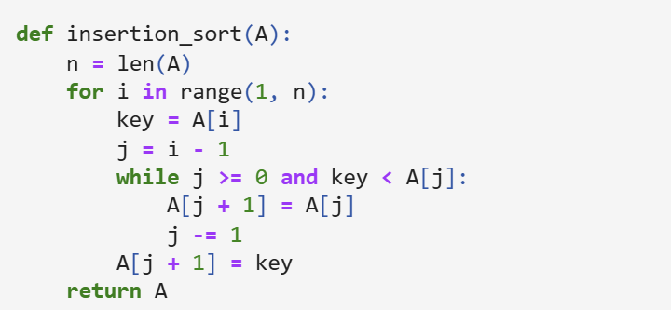
Insertion Sort

Slide 14
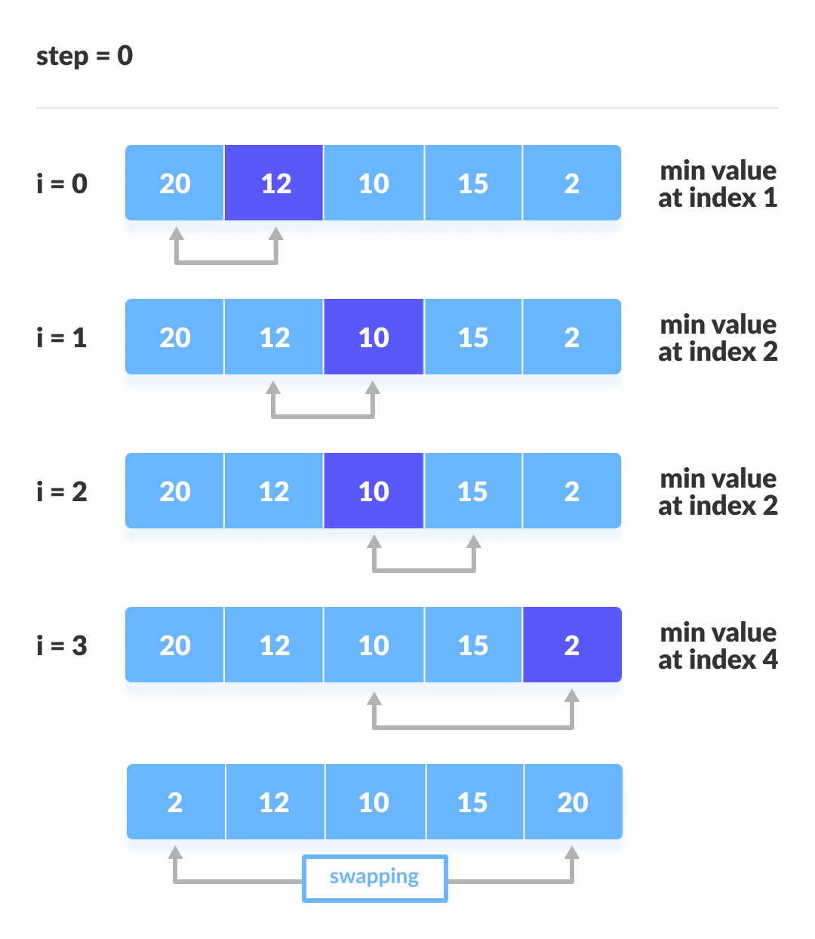
Selection Sort

Slide 15
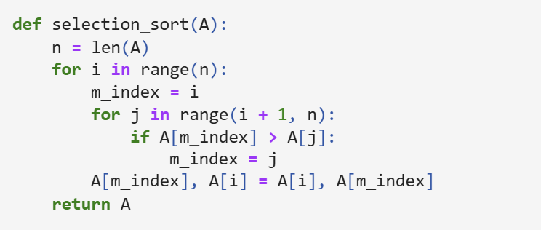
Selection Sort

Slide 16





Solving the Recurrence Equations

Slide 17
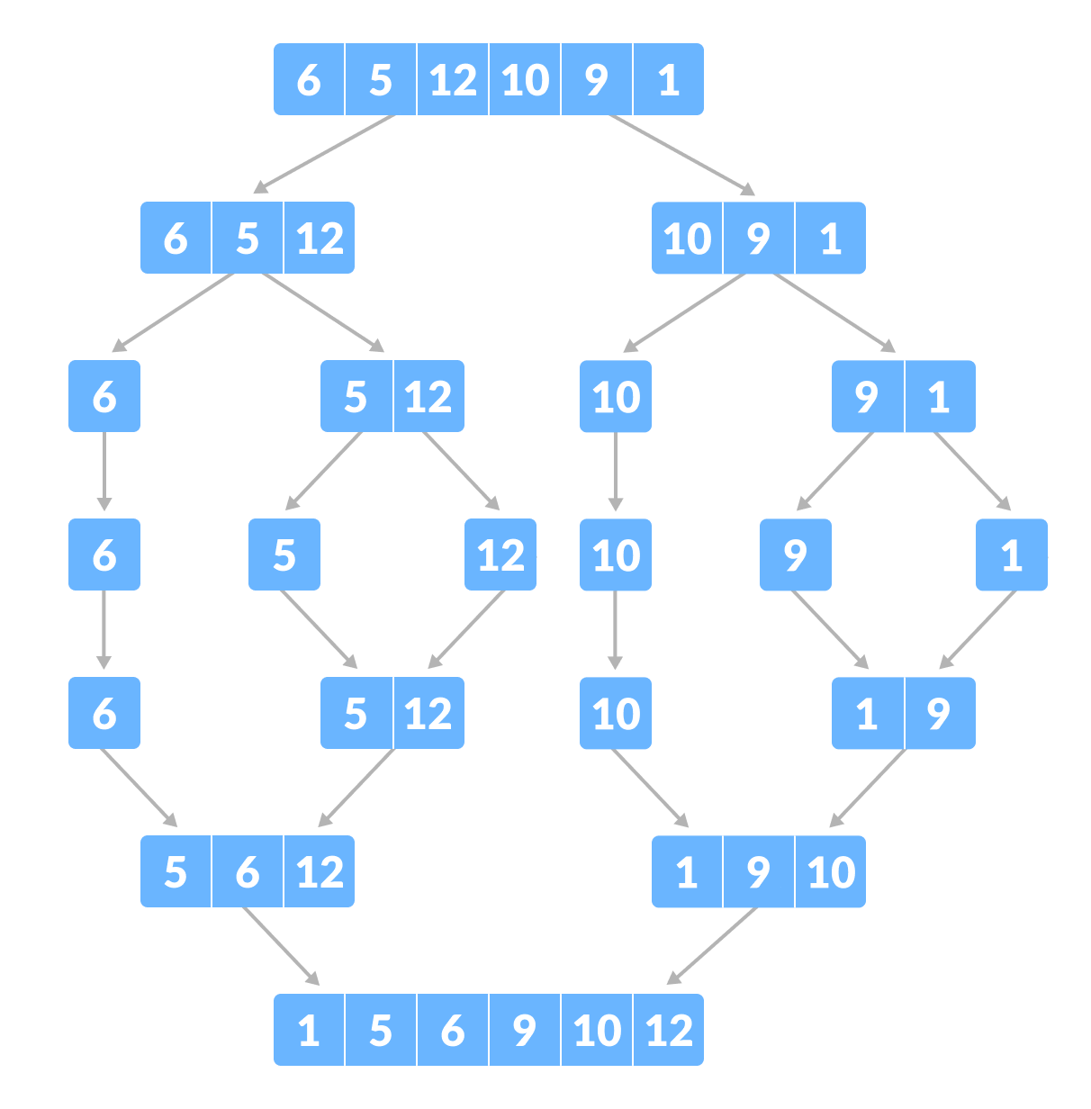
Merge Sort

Slide 18
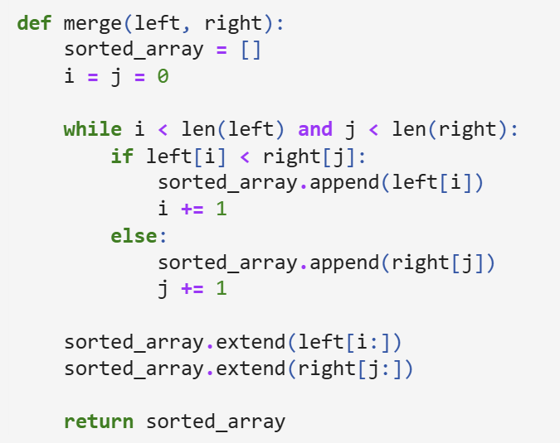
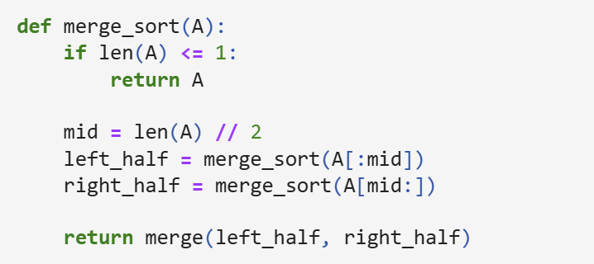
Merge Sort

Slide 19
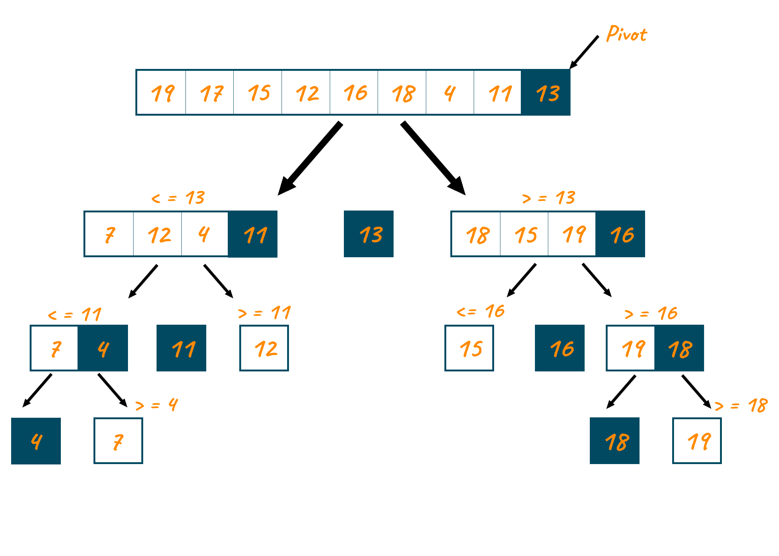
Quick Sort

Slide 20
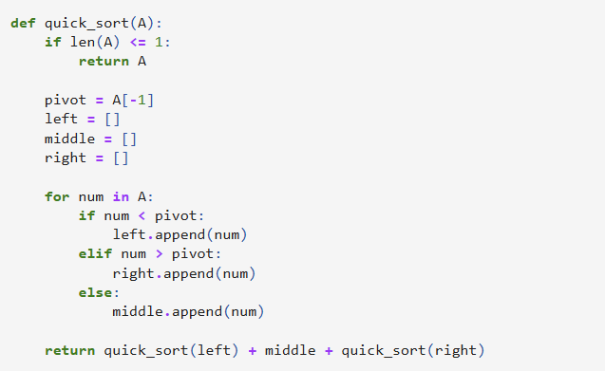
Quick Sort

Slide 21
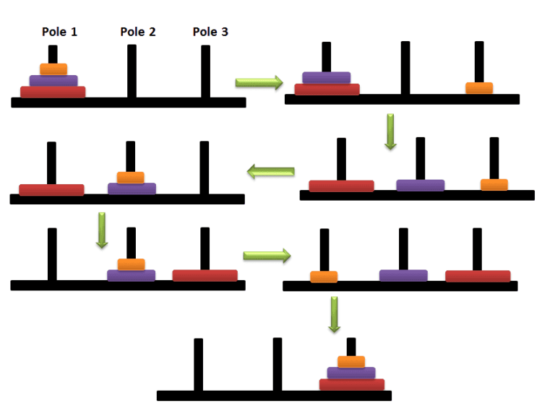
Hanoi Tower

Slide 22
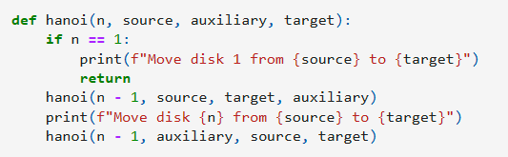
Hanoi Tower

